Slide 1
Oracle 11g: SQL
Chapter 4
Constraints

Slide 2
Objectives
Explain the purpose of constraints in a table
Distinguish among types of constraints and the appropriate use for each constraint
Understand how constraints can be created when creating a table or modifying an existing table
Distinguish between creating constraints at the column level and table level
Create PRIMARY KEY constraints for a single column and a composite primary key
Create a FOREIGN KEY constraint

Slide 3
Objectives (continued)
Create a UNIQUE constraint
Create a CHECK constraint
Create a NOT NULL constraint
Use DISABLE and ENABLE commands
Use the DROP command

Slide 4
Constraints
Rules used to enforce business requirements, practices, and policies
Rules used to ensure accuracy and integrity of the data in the database

Slide 5
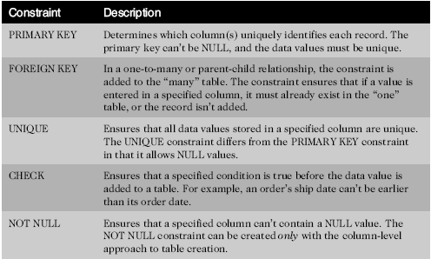
Constraint Types

Slide 6
Constraint Names
Internal name to identify the constraint, must be unique in a given schema
If you do not name a constraint, Oracle will generate a (very) un-intuitive name: SYS_Cn
Naming convention
  tablename_fieldname_constraintID
Primary key _pk
Foreign key _fk
Check condition _cc
Not NULL _nn
Unique key _uk
Notes:
Primary key _pk
Foreign key _fk
Check condition _cc
Not NULL _nn
Unique key _uk
e.g. student_studentid_pk

Slide 7
Creating Constraints
When
  During table creation
  Sometime after, by altering the existing table
How
  Column level approach
  Table level approach

Slide 8
Creating Constraints at the Column Level
If a constraint is being created at the column level, the constraint applies to the column specified

Slide 9
Creating Constraints at the Table Level
Approach can be used to create any constraint type except NOT NULL
Required if constraint is based on multiple columns

Slide 10
Enforcement of Constraints
All constraints are enforced at the table level
If a column data value violates a constraint, the entire row is rejected

Slide 11
Adding Constraints to Existing Tables
Constraints are added to an existing table with the ALTER TABLE command
Add a NOT NULL constraint using MODIFY clause
All other constraints are added using ADD clause

Slide 12
Using the PRIMARY KEY Constraint
Ensures that columns do not contain duplicate or NULL values
Only one per table is allowed

Slide 13
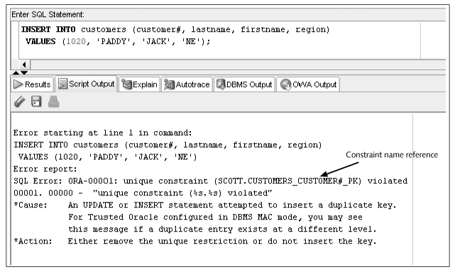
Constraint Checked with Data Input

Slide 14
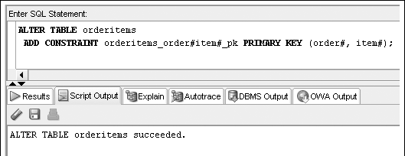
Composite Key PRIMARY KEY Constraint
List column names within parentheses

Slide 15
Using the FOREIGN KEY Constraint
Enforces referential integrity across tables
Requires a value to exist in the referenced column of another table
Maps to the PRIMARY KEY in referenced table
NULL values are allowed

Slide 16
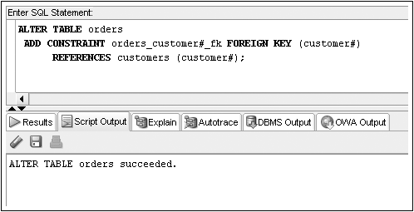
FOREIGN KEY Constraint Example

Slide 17
Deletion of Foreign Key Values
You cannot delete a value in a parent table referenced by a row in a child table
Be careful…If you use ON DELETE CASCADE keywords when creating FOREIGN KEY constraint, it automatically deletes a parent row when the row in a child table is deleted

Slide 18
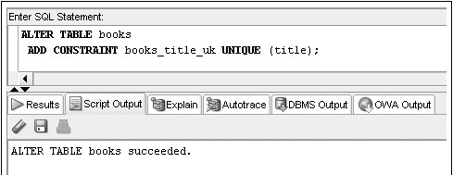
Using the UNIQUE Constraint
No duplicates are allowed in the referenced column
Notes:
NULL values are permitted
Usually for alternative identifiers

Slide 19
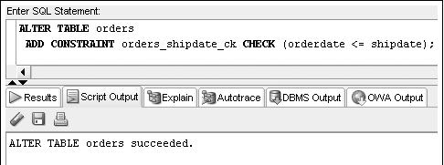
Using the CHECK Constraint
Any new or updated column values must meet specified condition
Notes:
Does not check any existing rows!

Slide 20
Using the NOT NULL Constraint
The NOT NULL constraint is a special CHECK constraint with IS NOT NULL condition for queries
Can only be created at column level
Included in output of DESCRIBE command
Can only be added to an existing table using ALTER TABLE…MODIFY command

Slide 21
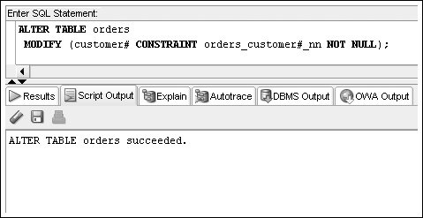
NOT NULL Constraint Example

Slide 22

Including Constraints during Table Creation – Column Level
Constraint clause included in column definition

Slide 23
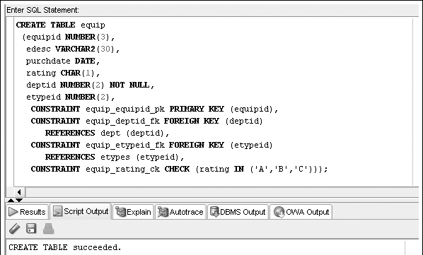
Including Constraints during Table Creation – Table Level
Include at end of column list

Slide 24
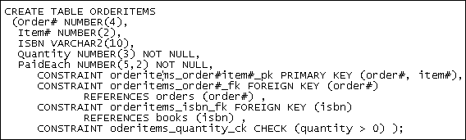
Multiple Constraints on a Single Column
A column may be included in multiple constraints
Notes:
e.g. order# column is included in a primary key and a foreign key constraint

Slide 25
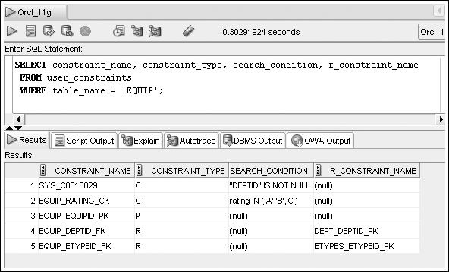
Viewing USER_CONSTRAINTS
Display constraint listing for a specific table

Slide 26
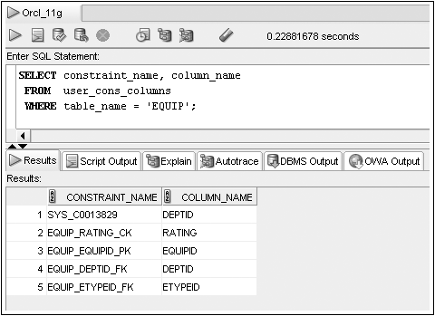
Viewing USER_CONS_COLUMNS
Display constraint listing by column

Slide 27
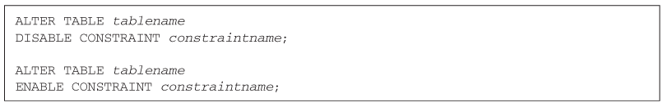
Using DISABLE/ENABLE
Use DISABLE or ENABLE clause of ALTER TABLE to temporarily stop then restart a constraint

Slide 28

Dropping Constraints
Constraints cannot be modified; they must be dropped and recreated
Actual syntax depends on type of constraint
  PRIMARY KEY – just list type of constraint
  UNIQUE – include column name
  All others – reference constraint name

Slide 29
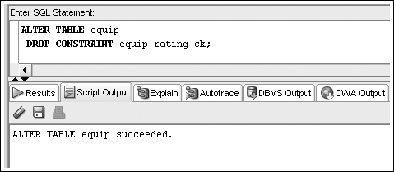
Drop Constraint Example

Slide 30
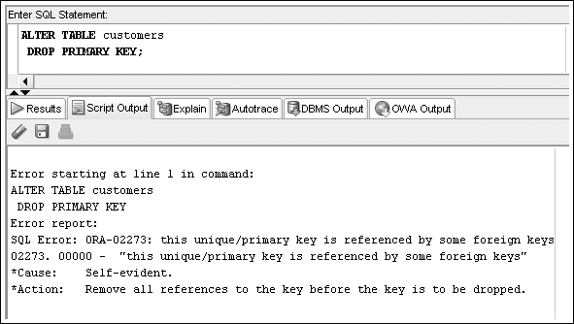
Drop Constraint Example – Error

